Slide 1
Intensity Transformations
P.Hema Sree

Slide 2
Contents
Intensity Transformation Functions
Some basic Gray Level Transformation

Slide 3
Spatial Domain?
Refers to the image plane (the ‘natural’ image)
Direct image manipulation
image = f(x,y))
Refers to the image plane (the ‘natural’ image)
Direct image manipulation

Slide 4
Spatial Domain
As we have a function, we can apply operators to this function, e.g.
T(f(x,y)) = f(x,y) / 2
Operator Image (= function !)

Slide 5
T transforms the given image f(x,y) into another image g(x,y)
f(x,y)
g(x,y)
T

Slide 6
The operator T can be defined over
The set of pixels (x,y) of the image.
The set of ‘neighborhoods’ N(x,y) of each pixel.
A set of images f1,f2,f3,…

Slide 7
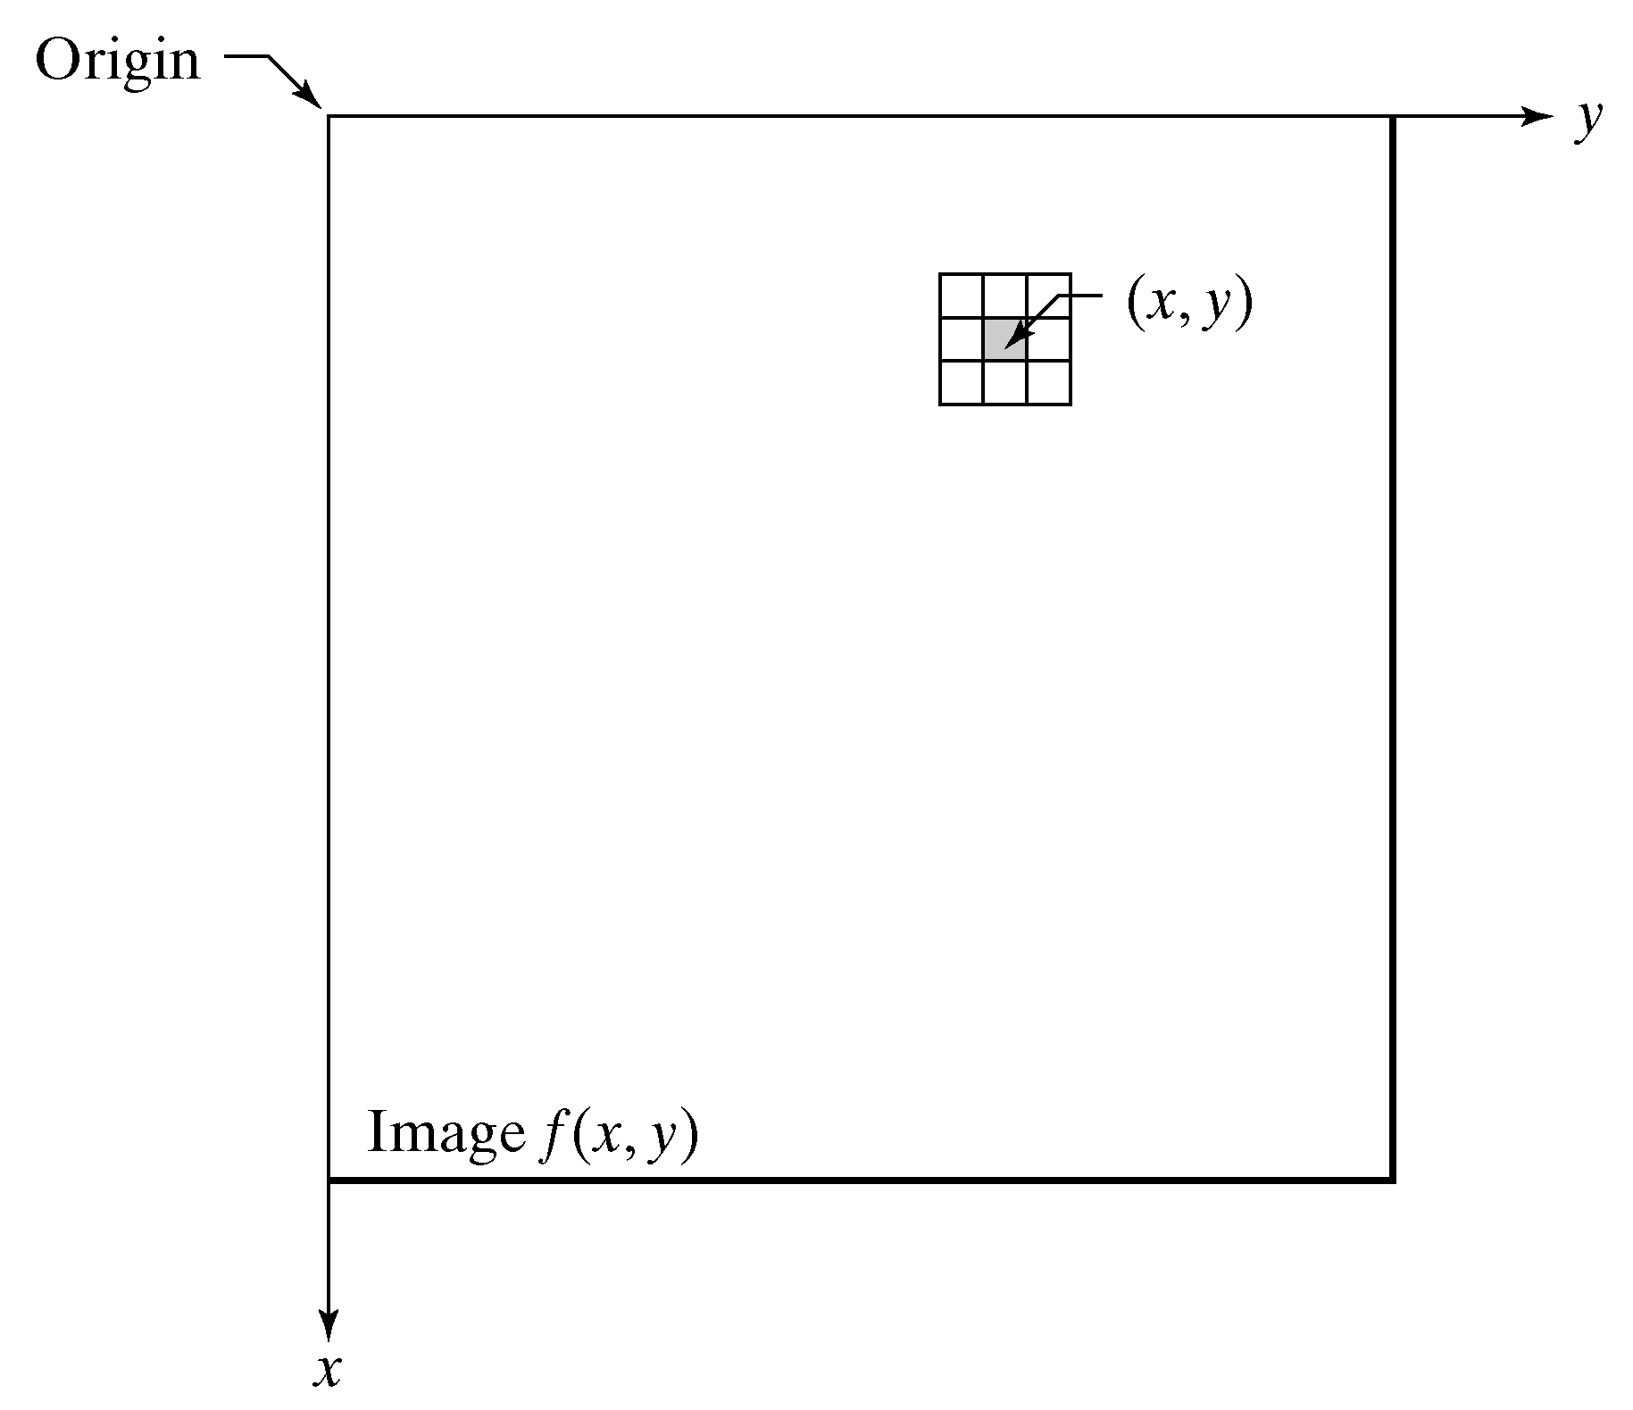
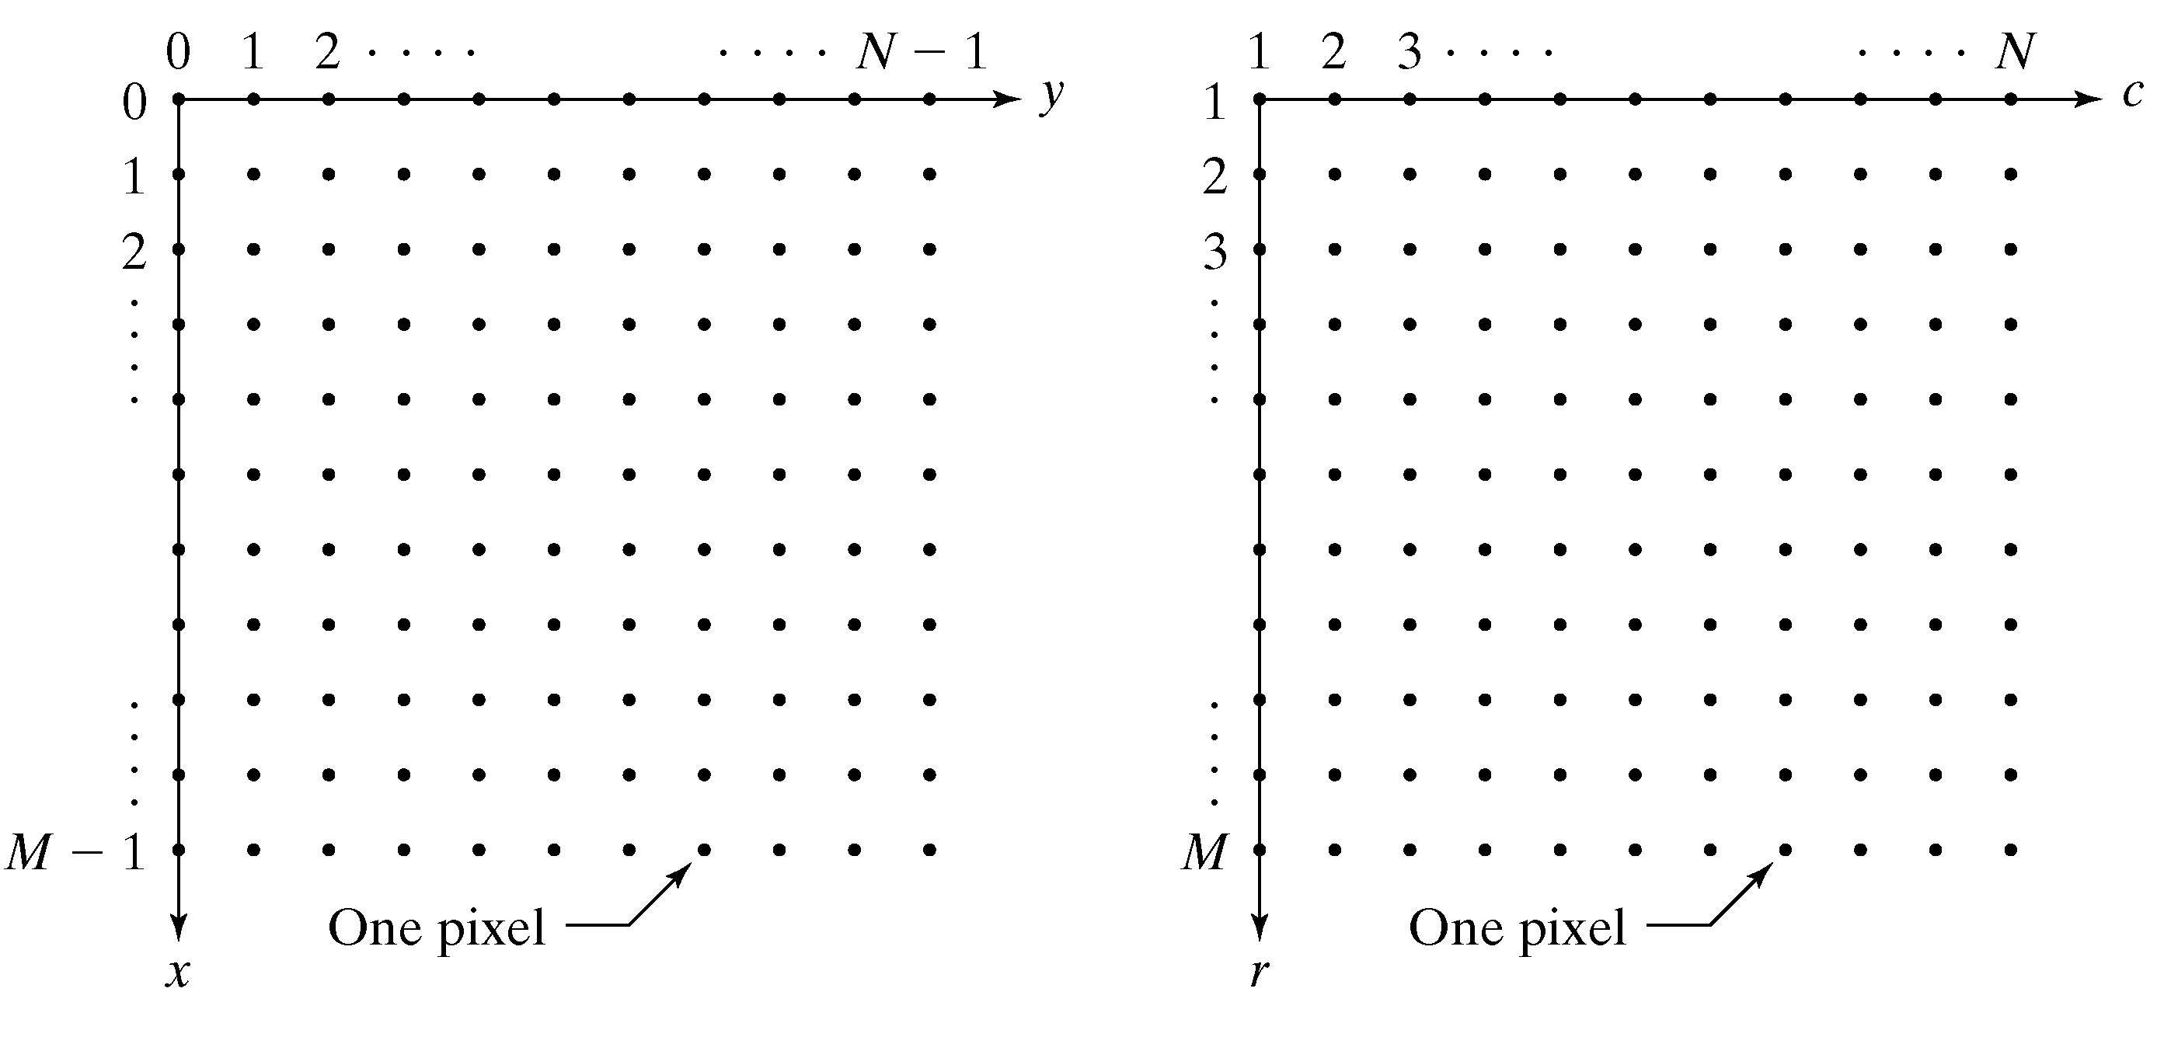

Slide 8
Spatial Domain Methods
Point
Processing
Area/Mask
Processing

Slide 9
Operation on the set of image-pixels
6
8
2
0
3
4
1
0
12
200
20
10
6
100
10
5
(Operator: Div. by 2)

Slide 10
Operation on the set of ‘neighbourhoods’ N(x,y) of each pixel
6
8
(Operator: sum)
12
200
6
8
2
0
226
12
200
20
10

Slide 11
Operation on a set of images f1,f2,…
6
8
2
0
12
200
20
10
(Operator: sum)
11
13
3
0
14
220
23
14
5
5
1
0
2
20
3
4

Slide 12
Operation on the set of image-pixels
These operations can also be seen as operations on the neighborhood of a pixel (x,y), by defining the neighborhood as the pixel itself.
The easiest case of operators
g(x,y) = T(f(x,y))
depends only on the value of f at (x,y)
T is called a gray-level or intensity transformation function

Slide 13
Function “imadjust”
Imadjust- the basic IPT tool for intensity transformation of gray scale image, the syntax is
g= imadjust (f, [low_in high_in], [low_out high_out], gamma)
This function maps the intensity values in image f to new values in g, such that the values between low_in and high_in map to values between low_out and high_out.

Slide 14
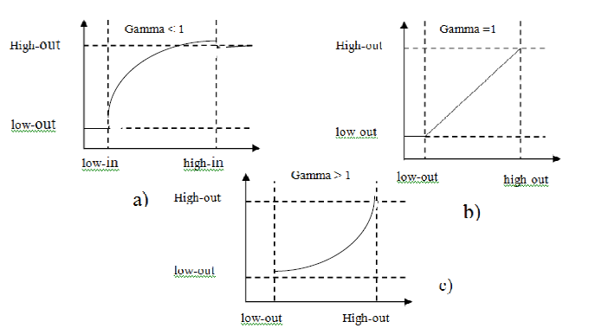
Parameter gamma: specifies the shape of the curve that maps the intensity value in f to create g.
gamma <1: the mapping is weighted toward brighter output values.
gamma = 1 (default): the mapping is linear>
gamma > 1: the mapping is weighted toward darker output values.

Slide 15
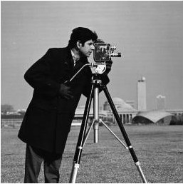
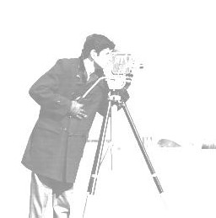
Intensity Transformation
Generally
Original | After Intensity Transformation

Slide 16
Basic Gray Level Transformations
• Linear Map
• Inverse Map/ Image Negatives
• Thresholding
• Windowing
• Log Transformation
• Power Law Transformation
• Contrast Stretching
• Intensity Slicing
• Bit Plane Slicing

Slide 17
Identity Transformation/Linear Map

Slide 18
Linear Map
When the linear map function has A < 1 the output range is smaller input range
• When pixels are stored in integers this results in quantization and loss of information
Example:
Input range [0..255]
Map(i) = i / 2 yields 128 intensity levels
Map(i) = i / 4 yields 64 intensity levels
Map(i) = i / 8 yields 32 intensity levels

Slide 19
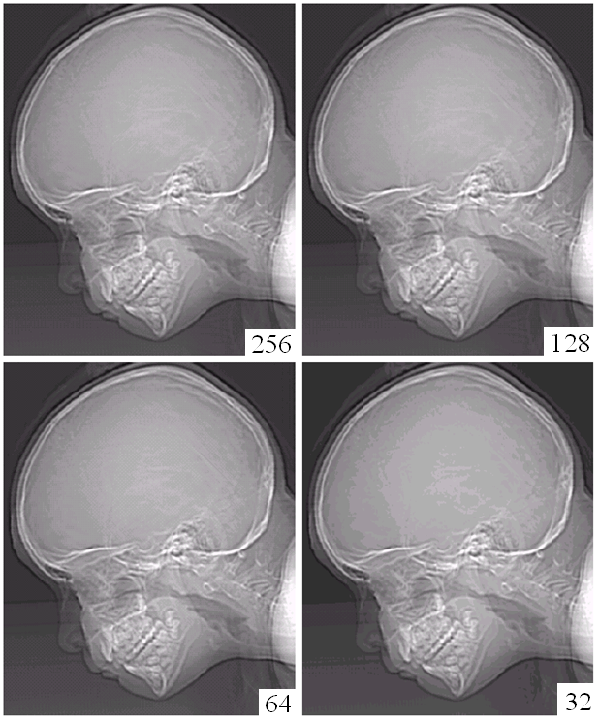
Linear Map

Slide 20
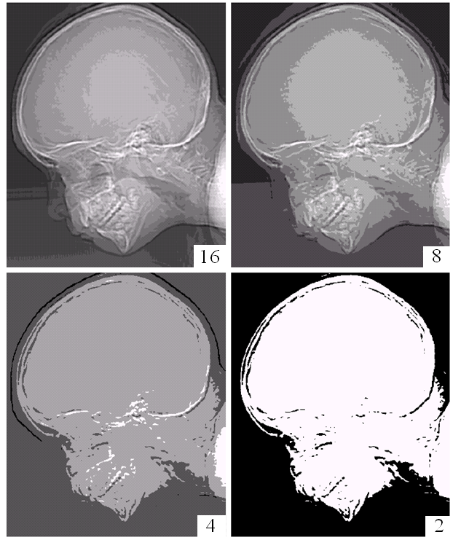
Linear Map

Slide 21
Image Negatives/Inverse Image: T(f)= L-f
T(f)=L-f
Output gray level
Input gray level

Slide 22
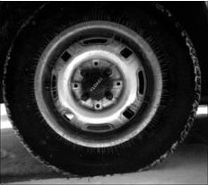
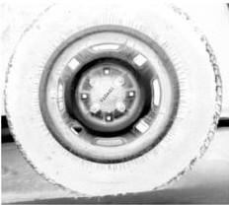
Image Negatives(imcomplement/imadjust)
I=imread('cat.JPG')
J=imcomplement(I);
imshow(I);
figure, imshow(J);

Slide 23
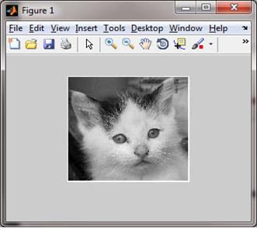
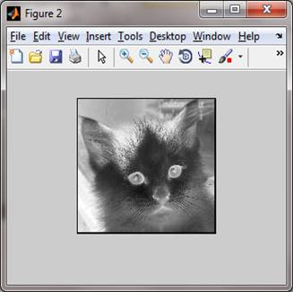
Image Negatives

Slide 24
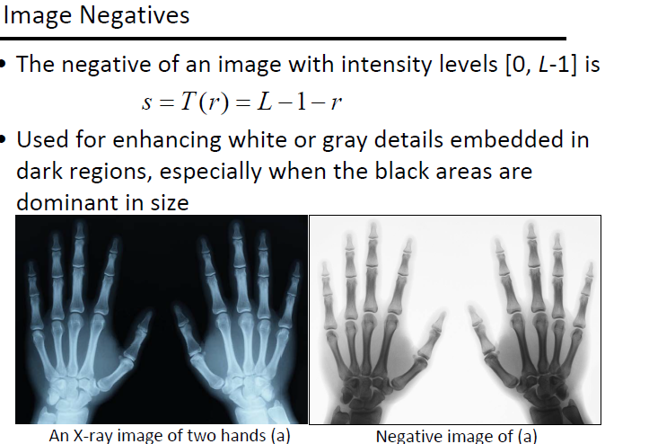

Slide 25
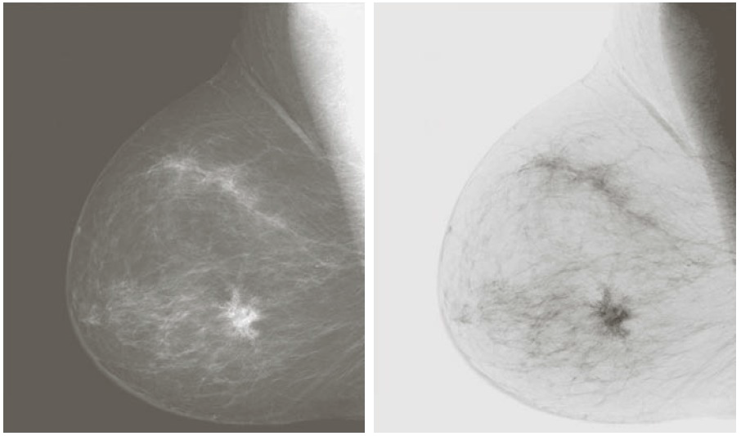
An inverse linear map will convert a negative
image into a positive image (and vice versa)
• Map(i) = 255 – i

Slide 26
Thresholding
An intensity transformation which produces a black and white output image
Map(i) = 0 if i < T
1 if i >= T
or
g(x,y) =L if f(x,y) > t,
0 else
Output gray level
Input gray level

Slide 27
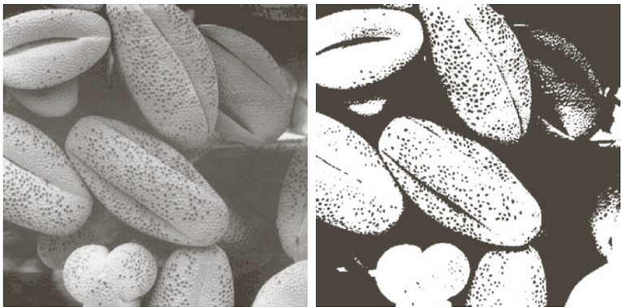
Thresholding
By selecting the threshold T we can separate objects of interest from the background

Slide 28
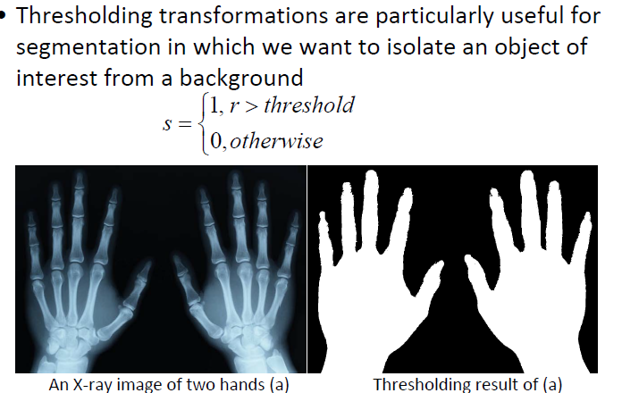
Thresholding(im2bw)
Used in Segmentation

Slide 29
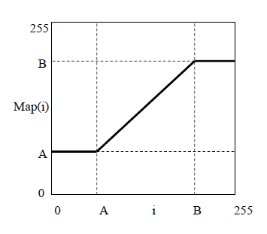
Windowing
When objects of interest have intensity values in the range [A..B] we can exclude all pixels outside this range to enhance object visibility.
Map(i) = A if (i < A)
B if (i > B)
i otherwise

Slide 30
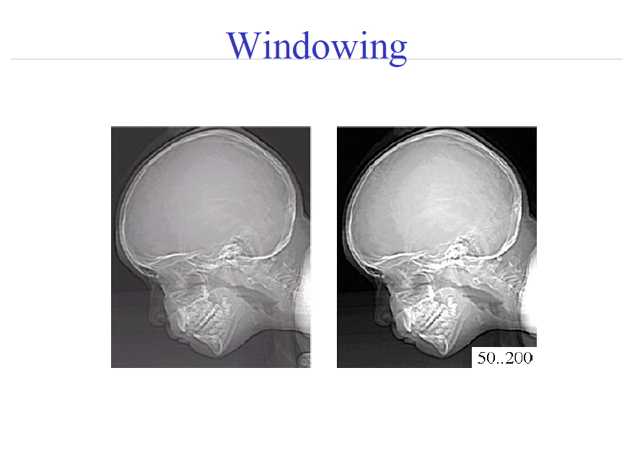

Slide 31
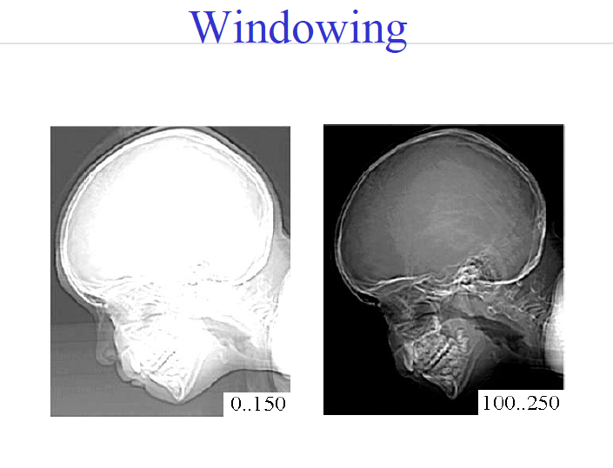

Slide 32
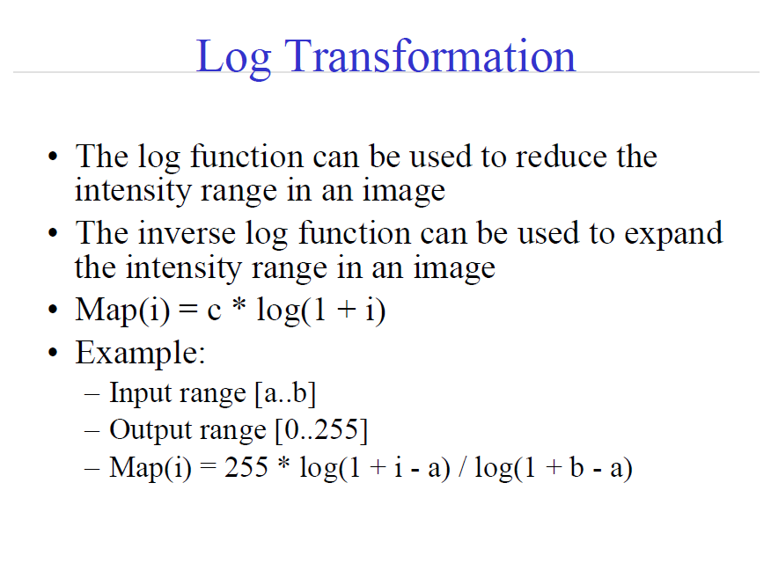

Slide 33
Log Transformation
T(f) = c * log (1+ f)

Slide 34
Log Transformation
InvLog
Log

Slide 35
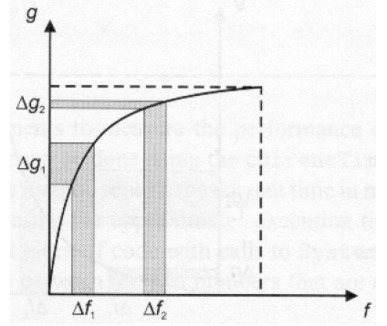
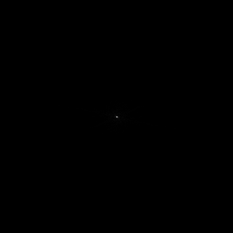
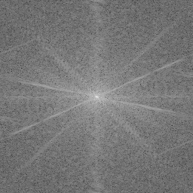
Logarithmic Transformation
Enhance details in the darker regions of an image at the expense of detail in brighter regions.
Often used to display Fourier Transform of an image
compress
stretch

Slide 36
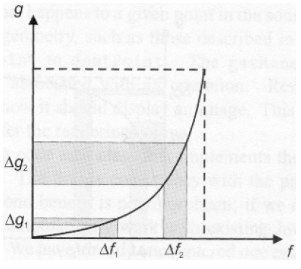
Exponential transformation
Reverse effect of that obtained using logarithmic mapping.

Slide 37
logaritmic transformations (using c*log(1+f))
usually, logarithmic transformation used to brighten the intensities of an image of lower intensity values. its function in matlab can be shown as, g = c*log(1+double(f)) . here, we paste some matlab code example for logaritmic transformation :)
>> I = imread('tire.tif');
>> I2=im2double(I);
>> J=1*log(1+I2);
>> J2=2*log(1+I2);
>> J3=5*log(1+I2);
>> imshow(I)
>> figure, imshow(J)
>> figure, imshow(J2)
>> figure, imshow(J3)

Slide 38
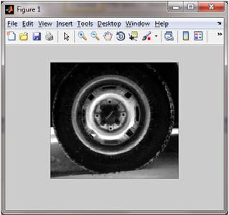
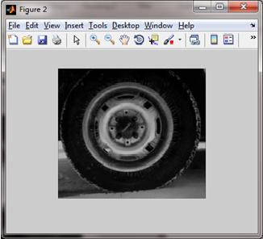
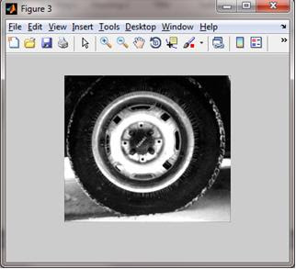
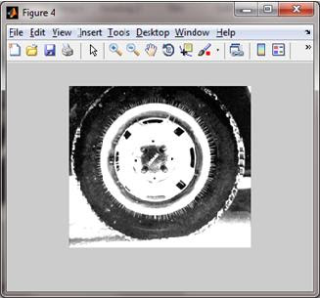

Slide 39
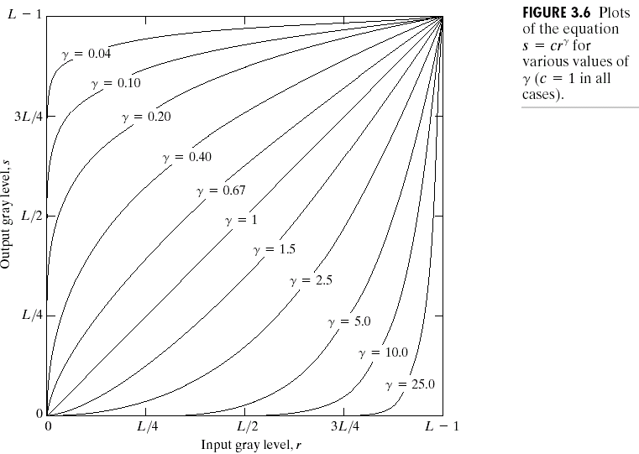
Power Law Transformations
P T(f) = c*f ^{γ}

Slide 40
Power Law Transformations (imadjust)
Varying gamma (γ) obtains family of possible transformation curves
γ > 1
Compresses dark values
Expands bright values
γ < 1
Expands dark values
Compresses bright values

Slide 41
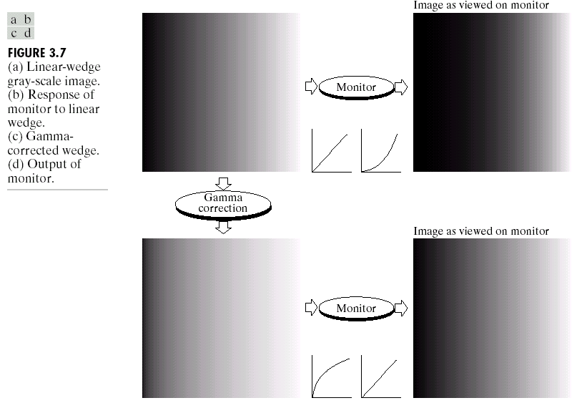
Used for gamma-correction

Slide 42
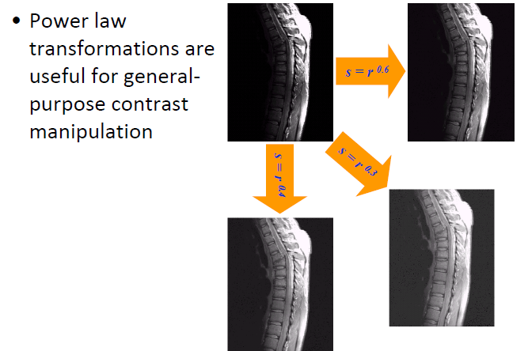
Used for general purpose contrast manipulation

Slide 43
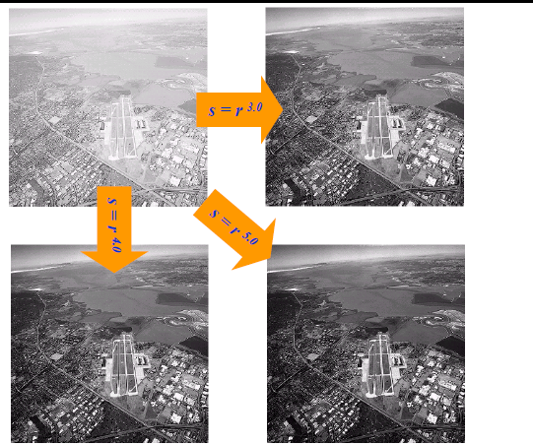
Power Law Gamma Transformation

Slide 44
Piece-wise Linear Transformations
Adv: Its form can be arbitrarily complex.
Disadv: requires more user input
Three usually used piece-wise linear transformation
Contrast stretching
Intensity-level-slicing
Bit-plane slicing

Slide 45
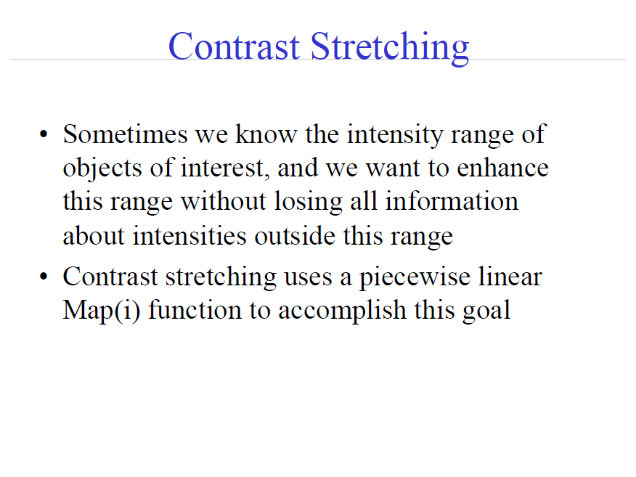
Constrast Strec

Slide 46
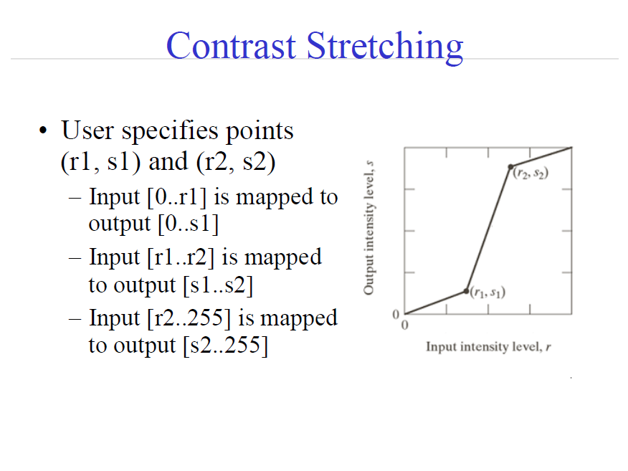

Slide 47
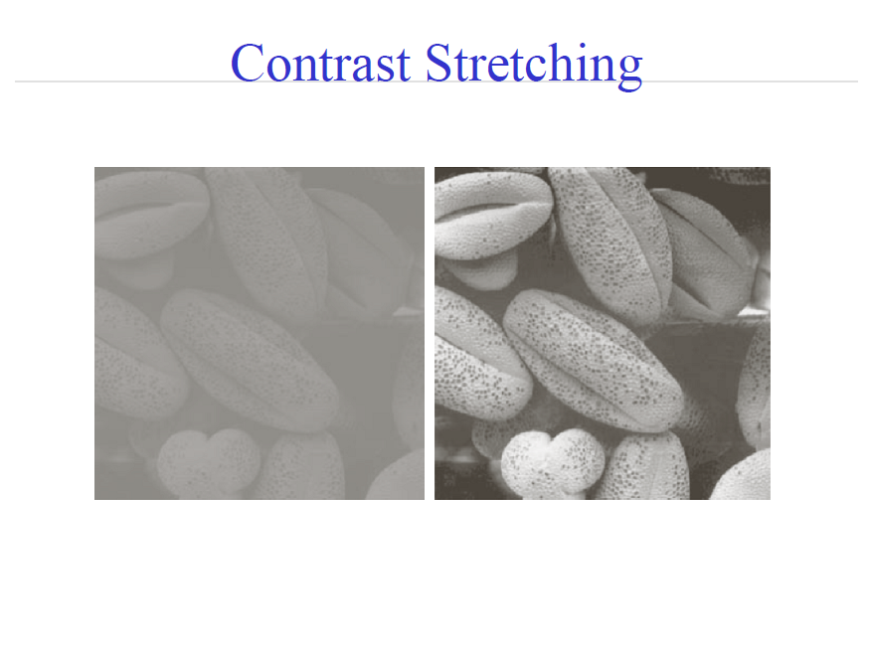

Slide 48
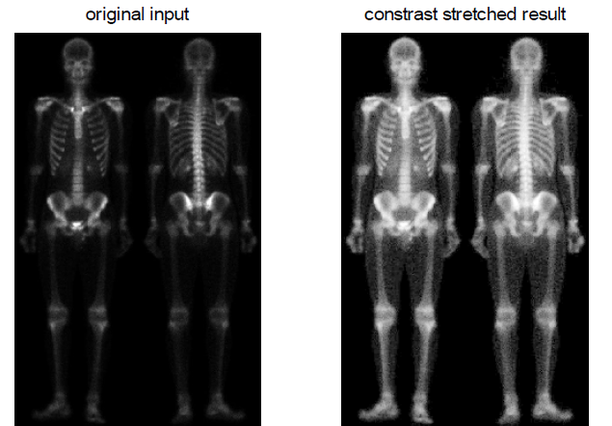
Contrast Stretching

Slide 49
Contrast Stretching
contrast-stretching transformations (using 1./(1+(m./(double(f)+eps)).^E)
this is the last part of intensity transformation for our lab. what is contrast-stretching transformation? urm, contrast-stretching transformation results in increasing the contrast between the darks and the lights. this will end up the dark being darker and the lights being lighter, with only few levels of gray in between. lets see our coding example and screenshot in plot form to enable readers to make contrast comparison easily :)
a) light to lighter
>> I = imread('tire.tif');
>> I2=im2double(I);
>> m=mean2(I2)
>> contrast1=1./(1+(m./(I2+eps)).^4);
>> contrast2=1./(1+(m./(I2+eps)).^5);
>> contrast3=1./(1+(m./(I2+eps)).^10);
>> figure(1), subplot(2,2,1),imshow(I2),xlabel('I2')
>> figure(1), subplot(2,2,2),imshow(contrast1),xlabel('contrast 1')
>> figure(1), subplot(2,2,3),imshow(contrast2),xlabel('contrast 2')
>> figure(1), subplot(2,2,4),imshow(contrast3),xlabel('contrast 3')

Slide 50
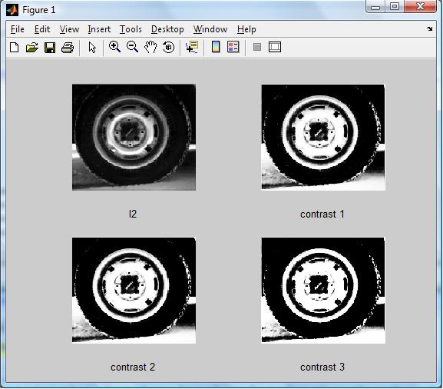

Slide 51
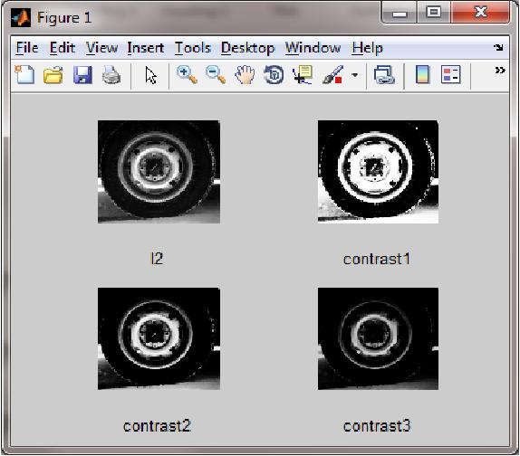

Slide 52
a) dark to darker
>> I = imread ('tire.tif');
>> I2=im2double(I);
>> contrast1 = 1./(1+(0.2./(I2+eps)).^4);
>> contrast2 = 1./(1+(0.5./(I2+eps)).^4);
>> contrast3 = 1./(1+(0.7./(I2+eps)).^4);
>>figure(1), subplot(2,2,1), imshow(I2), xlabel('I2')
>>figure(1), subplot(2,2,2), imshow(contrast1), xlabel('contrast1')
>>figure(1), subplot(2,2,3), imshow(contrast2), xlabel('contrast2')
>>figure(1), subplot(2,2,4), imshow(contrast3), xlabel('contrast3')

Slide 53
Gray Level/Intensity Slicing
Purpose: Highlight a specific range of gray values
Two approaches:
Display high value for range of interest, low value else (‘discard background’)
Display high value for range of interest, original value else (‘preserve background’)

Slide 54
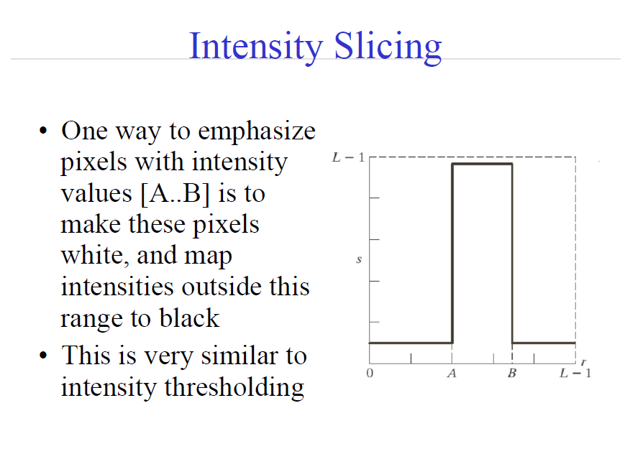
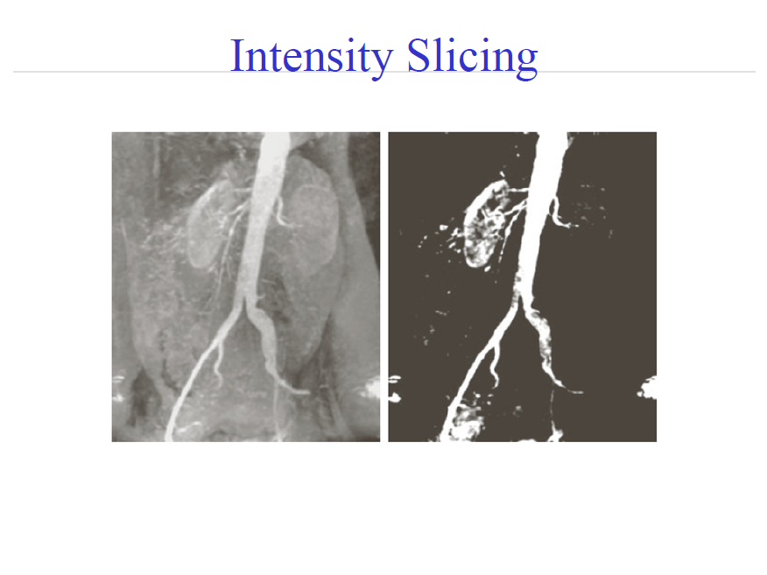

Slide 55
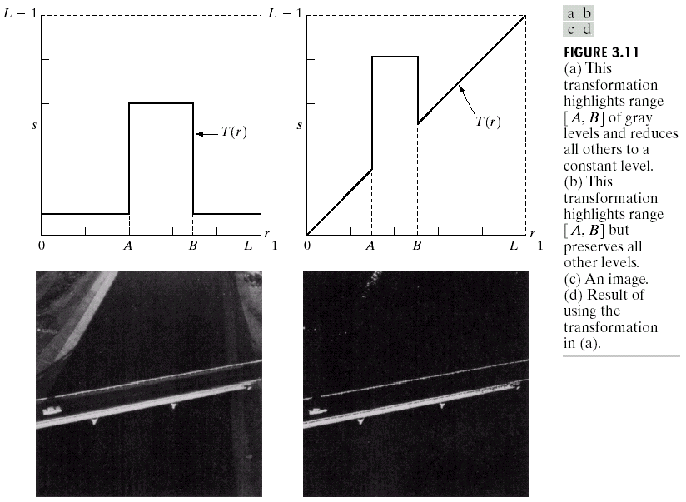

Slide 56
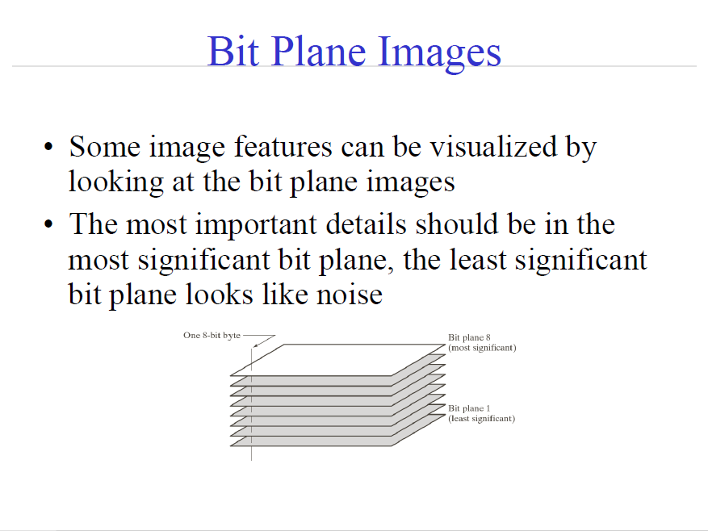

Slide 57
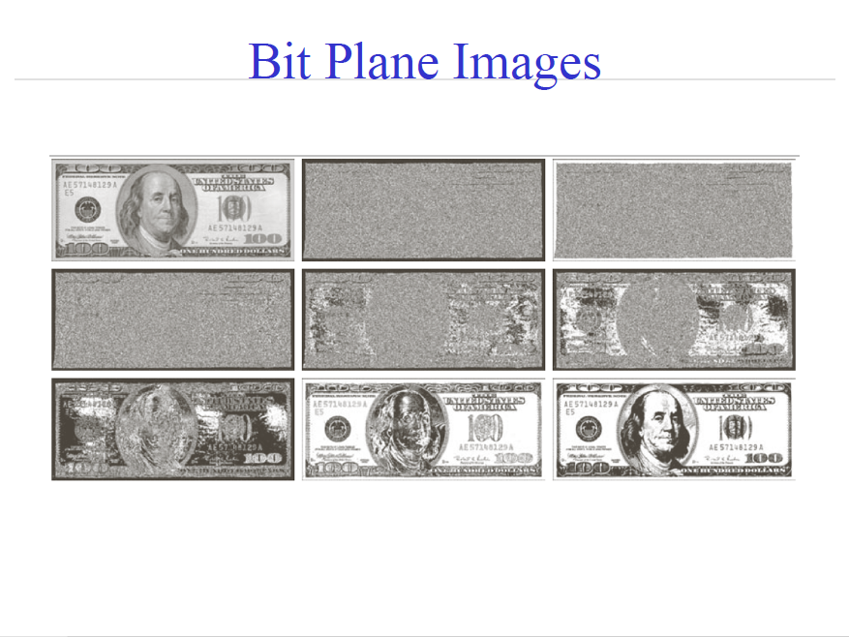

Slide 58
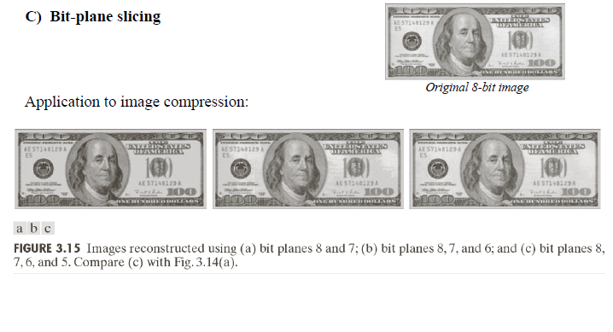

Slide 59
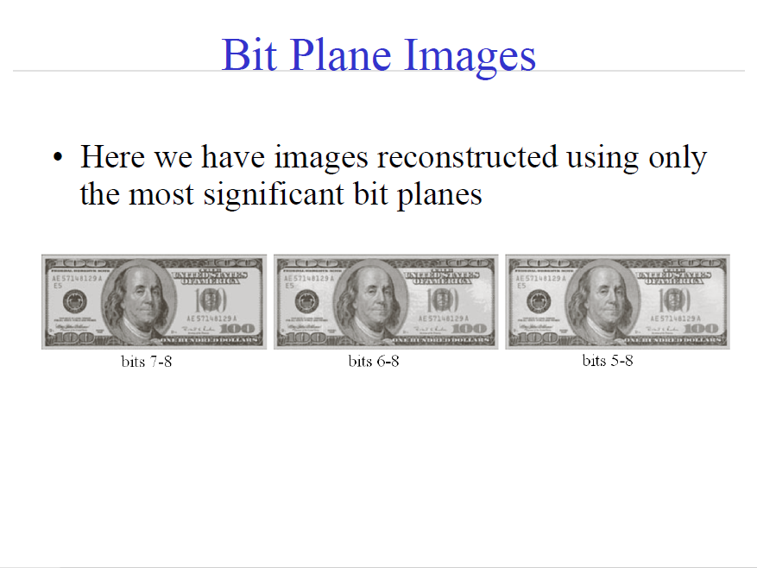
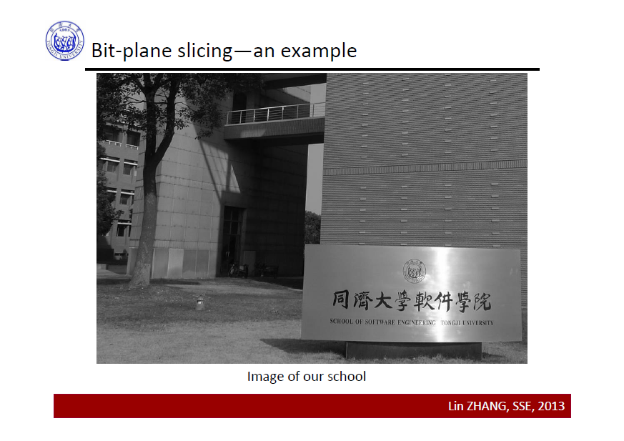

Slide 60
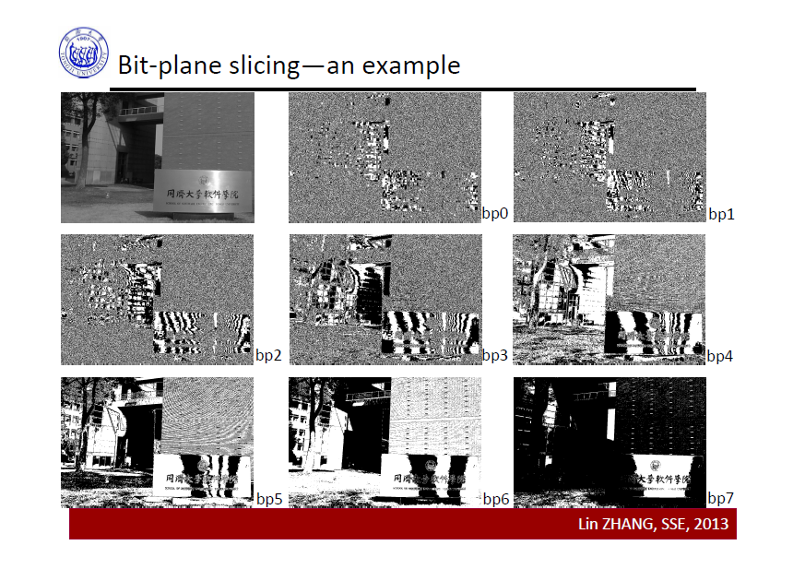

Slide 61
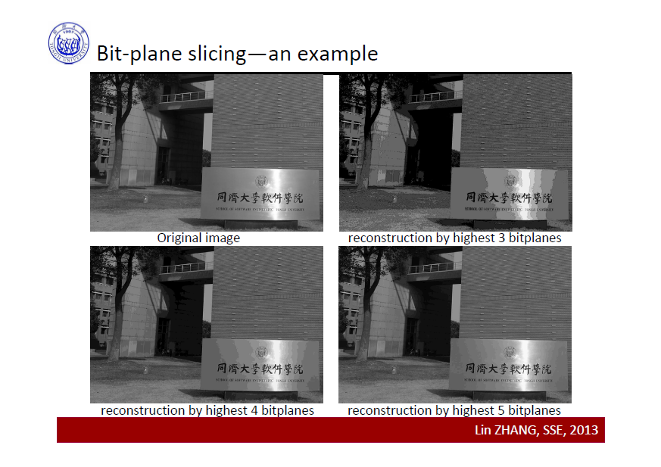

Slide 62
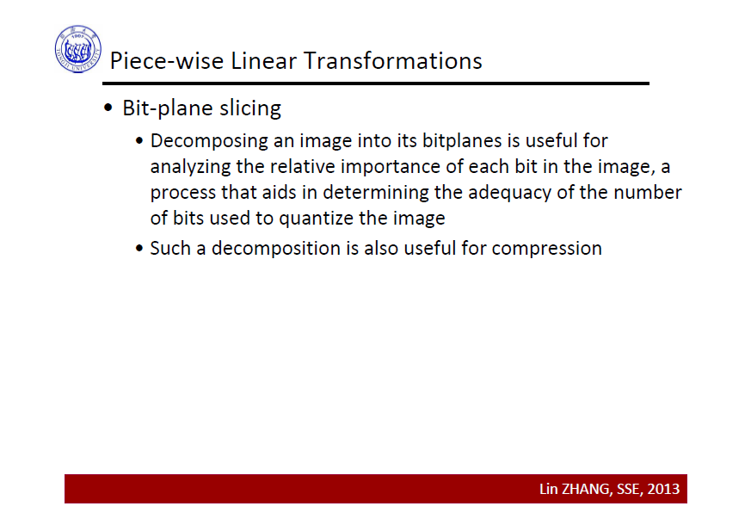

Slide 63
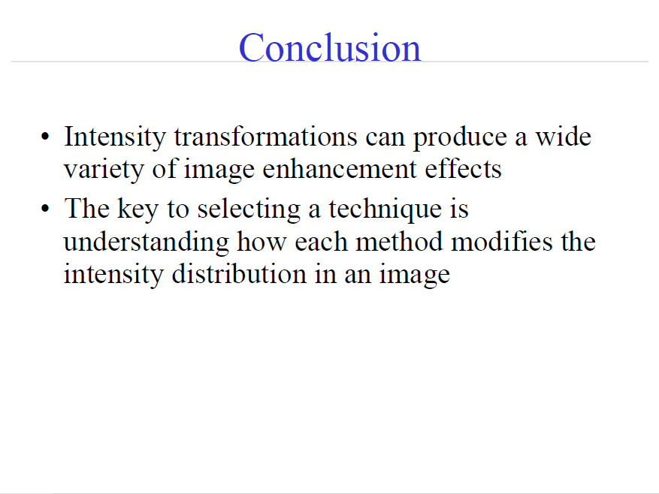

Slide 64
Thank you

